Slide 1


Slide 2

House Price Prediction Fairfax County, VA
Project 4, Group 1
GWU Bootcamp
Prepared and Presented by:
Adal, Louie, Patricia, Raheleh, and Rasha
6/12/2023

Slide 3

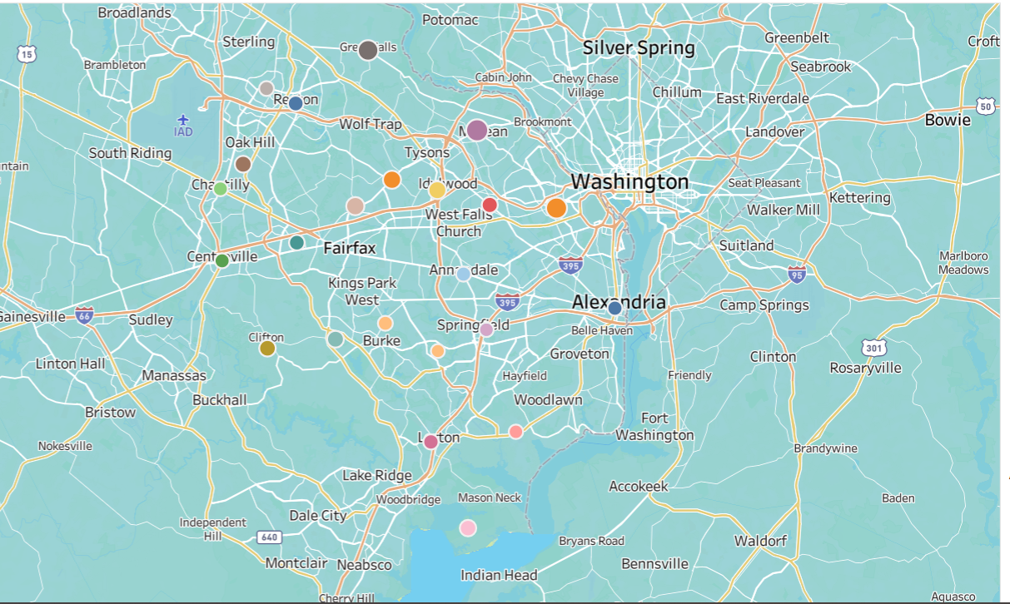
What and where to predicate?
1
Notes:
Raheleh
Single family home price in Fairfax County, VA

Slide 4
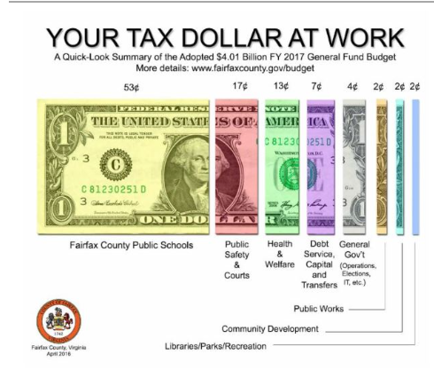
An Interest to Predict?
Who/where are people interested in housing prices?
General populations
Politicians seeking elections
Public workers
2
Notes:
Raheleh
Whether looking to relocate or increase wealth (65% of American owns home)
Education, tax incentive
https://www.fairfaxcounty.gov/topics/financial-transparency

Slide 5
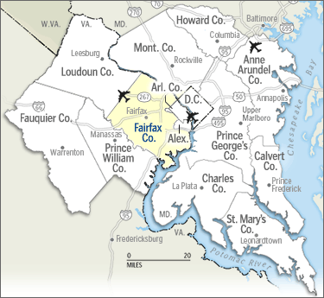
Fairfax County, VA Housing Predication
Why Fairfax, VA Houses:
More than half of this team lives in Fairfax, VA
Access to VA Multiple Listing Service (MLS)
Most populated county in VA
Best public schools in VA
3
Notes:
Raheleh
It is almost 3 times more populated than Loudoun and Prince Williams County
25the best county to live in and third best in VA
https://www.ffxnow.com/2023/03/28/heres-where-fairfax-county-ranks-among-the-best-counties-to-live-and-the-neighbor-it-couldnt-beat/#:~:text=Fairfax%20County%20was%20named%20the,families%20choose%20schools%20and%20neighborhoods.
https://www.virginia-demographics.com/counties_by_population
https://www.ffxnow.com/2023/03/28/heres-where-fairfax-county-ranks-among-the-best-counties-to-live-and-the-neighbor-it-couldnt-beat/#:~:text=Fairfax%20County%20was%20named%20the,families%20choose%20schools%20and%20neighborhoods.

Slide 6
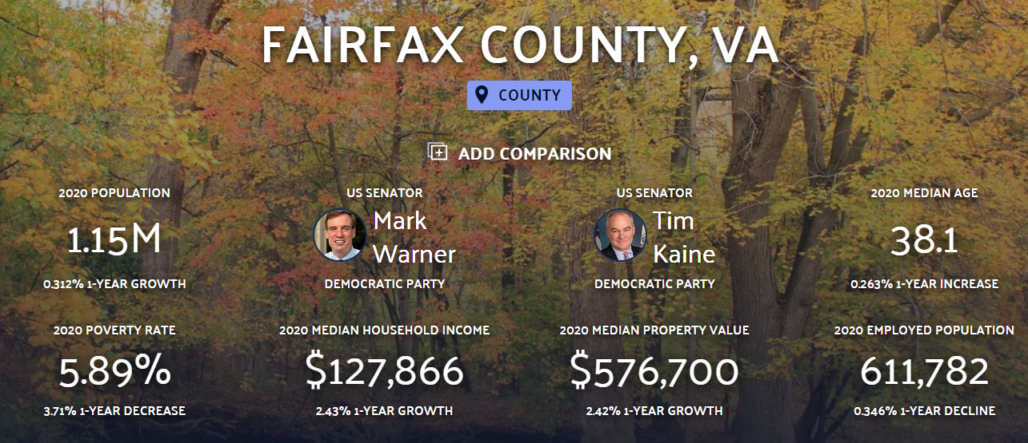
Fairfax County, VA Housing Prediction
4
Notes:
Raheleh
https://datausa.io/profile/geo/fairfax-county-va

Slide 7

Data Exploration, Cleaning and Wrangling :
The data exploration and cleanup process
Fetched the data from Bright MLS Website
Saved the CSV files to our local drive
~31k rows of data,
Only used January 1, 2019- April 2023 (~30,984, cleaned data: ~29,000)
Sold single family homes in Fairfax County VA
Import all the required libraries or dependencies
Import the Fairfax County 2019-2023 house sale csv data
Convert the physical addresses to Lat/Lon coordinates using geoapify API
Exploratory Data Analysis (EDA)
Data Visualization the dependent variable (Sold Price) vs other independent variables
Create machine learning model
Evaluate the machine learning model using evaluation metrics
Extract & Transform
5
Notes:
Louie
- Could only save up to 5000 rows of data at a time

Slide 8
Data Exploration, Cleaning and Wrangling:
Dropped Unnecessary Columns (17 to 13 )
Dropped Rows with Null Values
Changed Datatypes
Converted the date values to year and month , “yyyy/mm” datatype
Converted number values into “int” datatype
Converted object values into “float” and “int” datatype
Analyzing columns/data
Split full bath from half baths
Identified the target variable, Home sale price in Fairfax, VA
Split the data into test and train variables
Implemented dummies for categorical data, Cities (23) in Fairfax, VA
Utilized a scaler
Removed the outliers by using interquartile range (IQR), upper quartile- lower quartile
Extract & Transform
6
Notes:
Louie

Slide 9
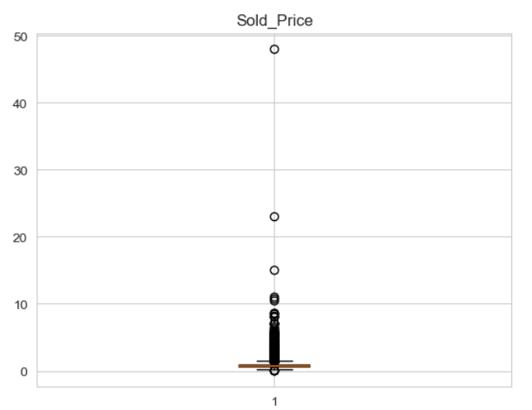
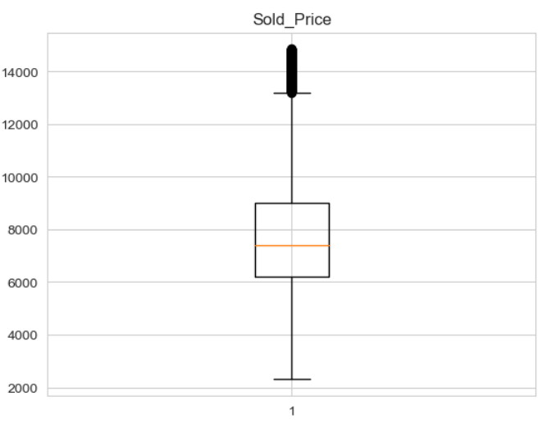
Data Cleaning/Process- Box Plots:
In Millions
In Hundreds
7
Notes:
Rasha—Left (divided by a million)--- right (divided by 100), 200,000, 400,000
Before dropping out the outliers (before and after)…

Slide 10
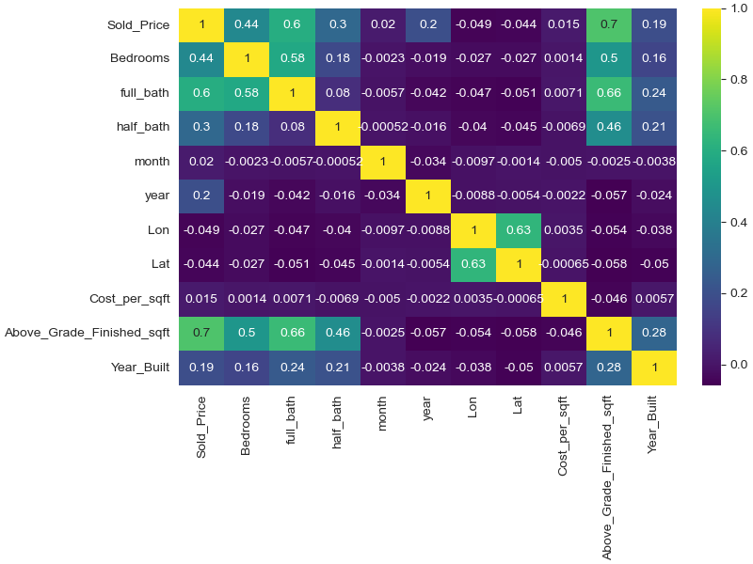
Correlations with Sold Price (Heatmap):
8
Notes:
Rasha
Sold price is the target value…. There are many variables but the most correlated one is Above grade finished SQFT.. Which is 70% correlated to the sold price

Slide 11
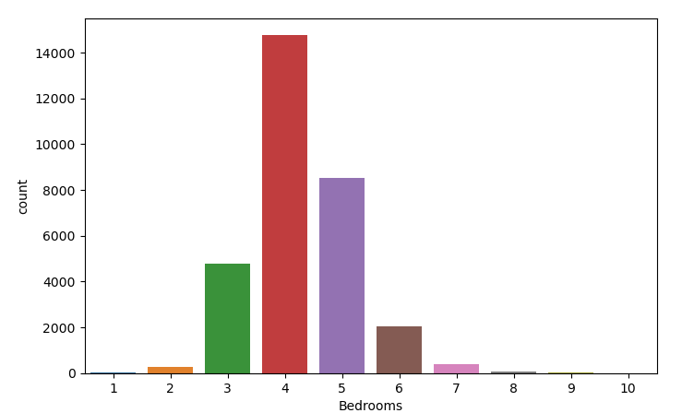
Number of Sold Homes with Avg Bedrooms:
9
Notes:
Rasha

Slide 12
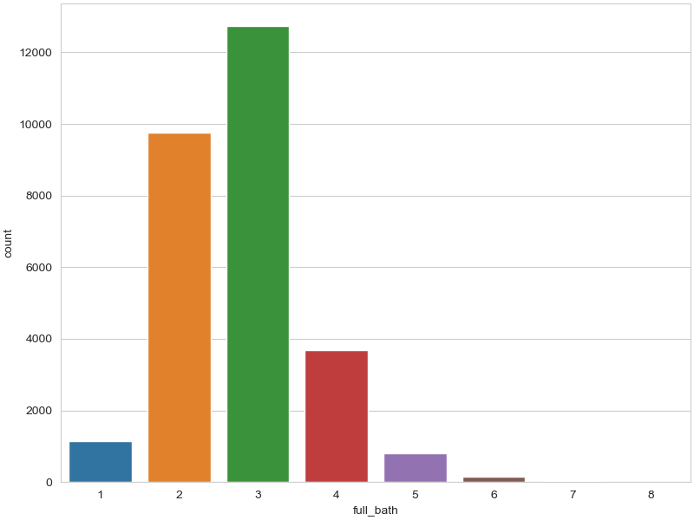
Number of Sold Homes with Avg Full Baths:
10
Notes:
Rasha

Slide 13
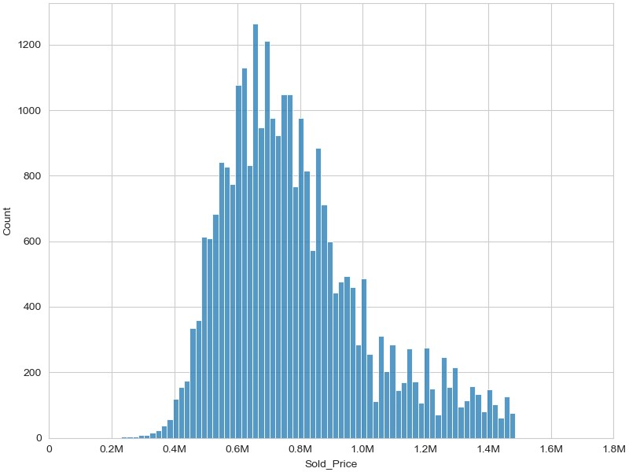
House Sold Price and Count:
11
Notes:
Patricia
about 29,000 rows of data

Slide 14
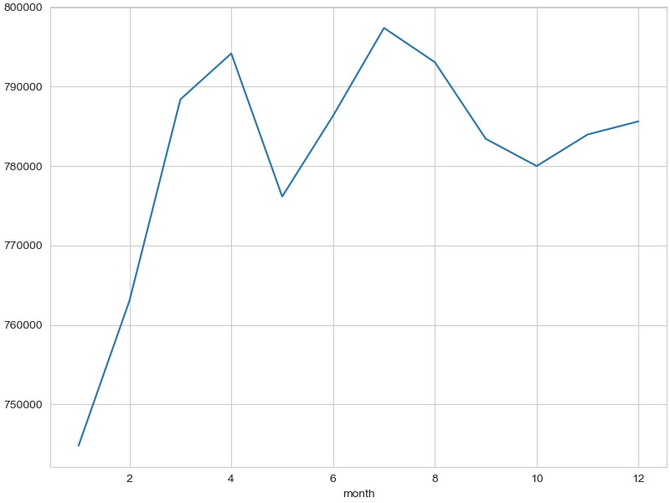
Avg House Price Sold per Month:
Avg House Price Sold
12
Notes:
Patricia

Slide 15
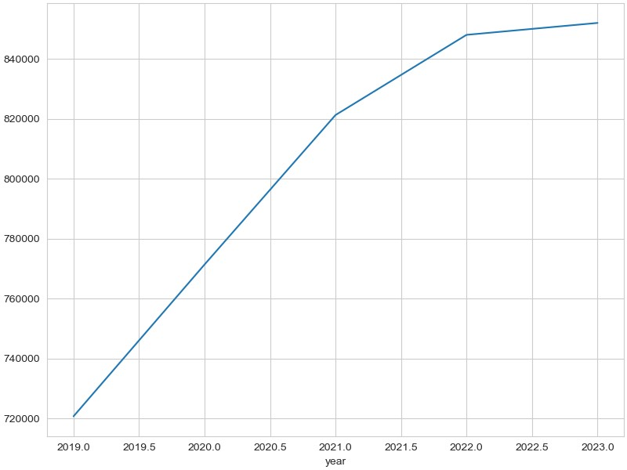
Avg House Price Sold per Year:
Avg House Price Sold
13
Notes:
Patricia

Slide 16
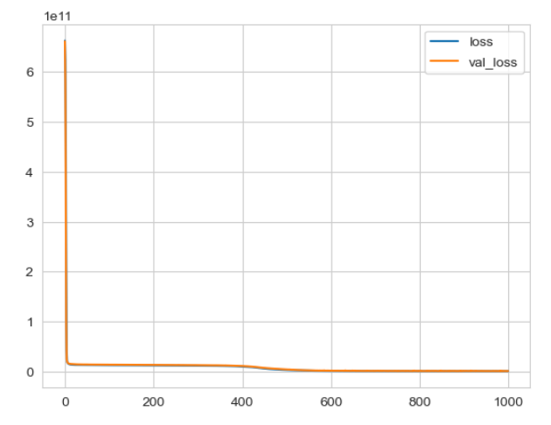
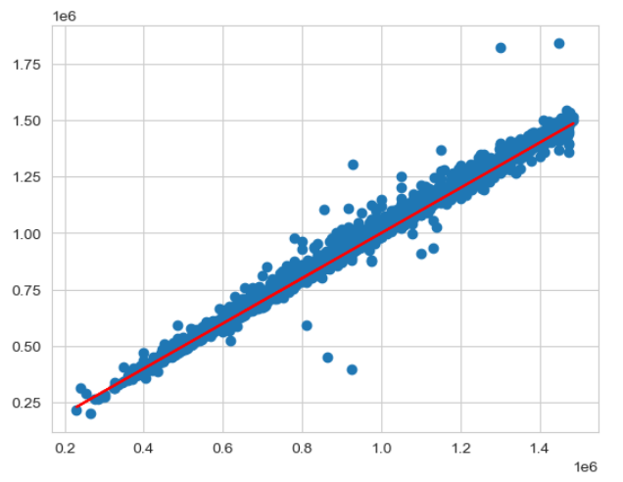
Compile, Train, and Evaluate Model: Training the Model Without Dropout/Early Stop Layer: 1 of 4
14
Notes:
Adal
R2=0.9892285680512334

Slide 17
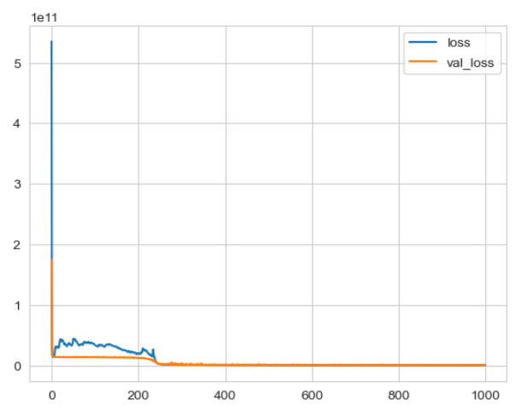
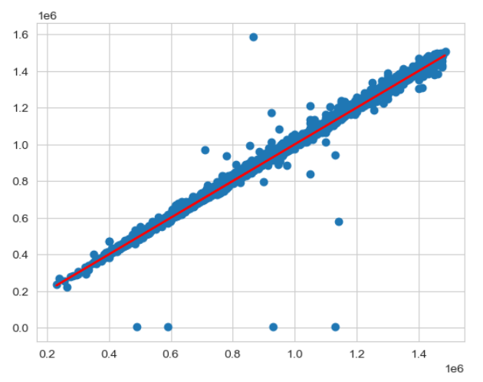
Compile, Train, and Evaluate Model: Training the Model with Early Stop: 2 of 4
15
Notes:
Adal
model = Sequential()
model.add(Dense(102, activation = 'relu'))
model.add(Dense(102, activation = 'relu'))
model.add(Dense(102, activation = 'relu'))
# Output layer
model.add(Dense(1, activation = 'linear'))
model.compile(optimizer = 'rmsprop', loss = 'mse')

Slide 18
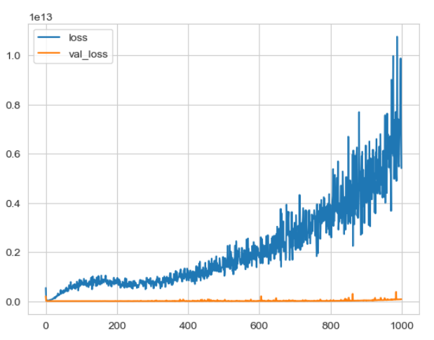
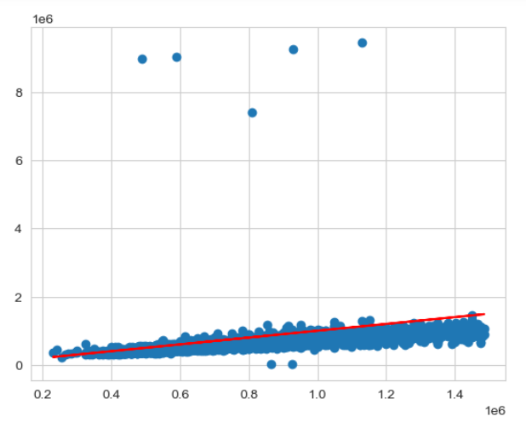
Compile, Train, and Evaluate Model: Training the Model with Dropout Layer & Early Stop: 3 of 4
16
Notes:
Adal

Slide 19
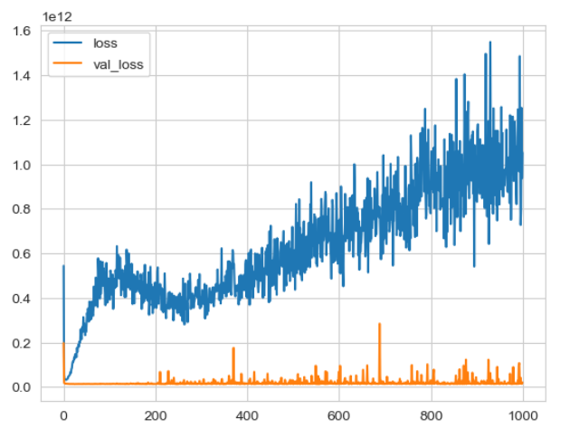
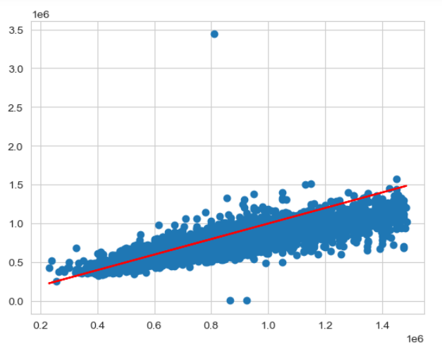
Compile, Train, and Evaluate Model: Training the Model with Dropout Layer Only: 4 of 4
17
Notes:
Adal

Slide 20
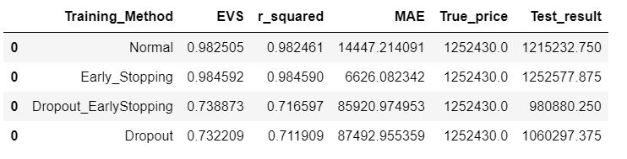
Compile, Train, and Evaluate Model Final Summary/Optimized Model:
Extract & Transform
18
Notes:
Louie

Slide 21


Questions
19

Slide 22
Back up Slides
20

Slide 23
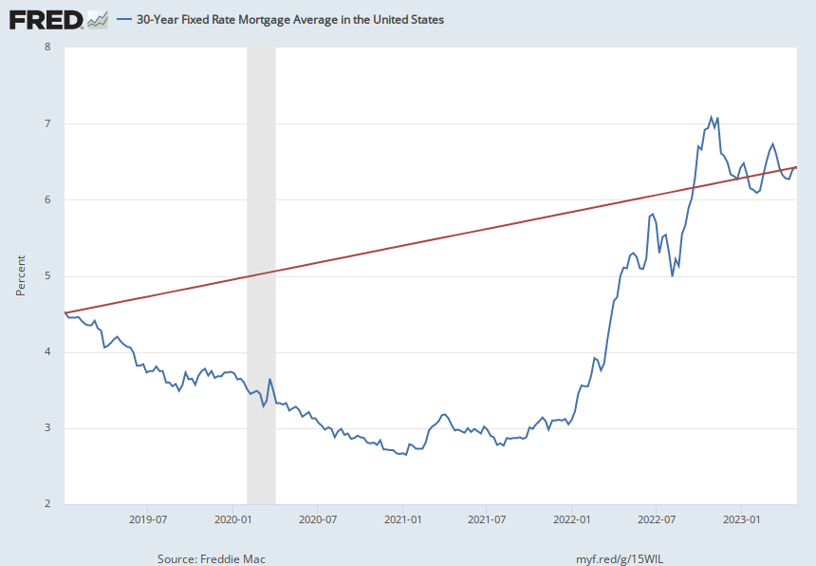
Mortgage Rates and Effect on Housing Prices:
21
Notes:
Raheleh
https://fred.stlouisfed.org/series/MORTGAGE30US#0

Slide 24
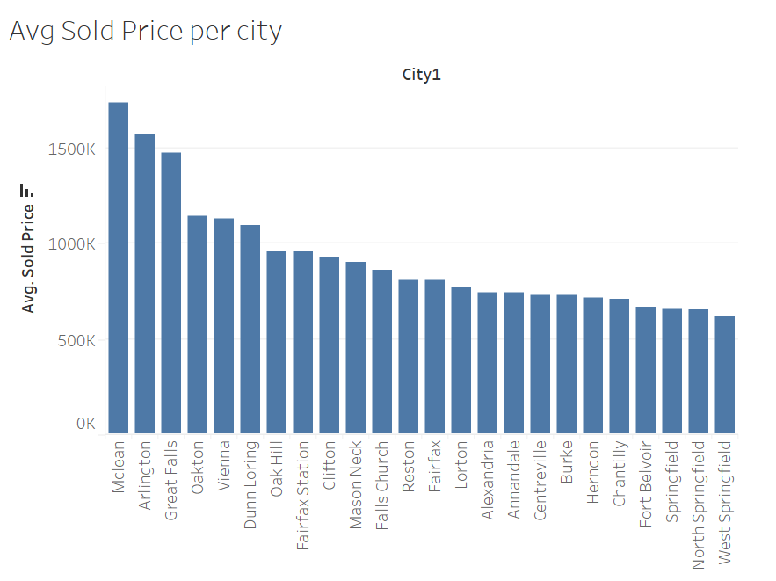
Avg Sold Price per City:
21
Notes:
Raheleh
https://fred.stlouisfed.org/series/MORTGAGE30US#0

Slide 25
Project and Data Links:
GitHub
https://github.com/rvafaeis/project_4_ML_Fairfax_home_price
Data Links
https://www.brightmls.com/home
Tableau Dashboard
https://public.tableau.com/app/profile/raheleh.vafaei.saadi/viz/FairfaxVASFHomePrice/SoldPriceperCity?publish=yes
22

